Slide 1


Great shopping product launch
Team-5
Srilekha Matam
Gaayathri Balu
Prathik Anil Bambal

Slide 2

The Business Process to Automate
Problem Statement :-
Great Shopping – Digital Marketing
Great Shopping is one of the leading online retailers in the UK having millions of customers. There are many customers opted for notification on a new product to be launched during next week. The company needs to send an email message and WhatsApp message informing the launch date.
Your team needs to develop and train a bot to automate this digital marketing business process for ‘Great Shopping’.

Slide 3
Challenges
Manpower:-
Need to send WhatsApp message for new product launch
Send Email notification to 10,000 customers of company need almost 40 Employees
Manual process consume more Time as compare Automation it's take 2 days to send notification to 10000 customer
Time taken is more for 40 Employees
It's also consume cost it's take 2 days salary of 40 employee around Rs 80,000
Time:-
Cost:-

Slide 4
Project Requirement
Accessing the databse in MSACCESS
Extracting the data from access ato excel.
Sending whatsapp messages by reading customer details in excel file.
Sending mail to the customers present in the customer table.

Slide 5
Feasibility Analysis
Hand-written Documents | Not in scope of this business process
Judgement Call – Decision making ability by a human | Not in scope of this business process
Fuzzy Logic – Flow should have either ‘Yes’ or ‘No’ Answers. | Not in scope of this business process

Slide 6
Bot Design Steps
Great Shopping Product Launch Process Automation
Database Automation
Excel Automation
Web Automation
Email Automation

Slide 7
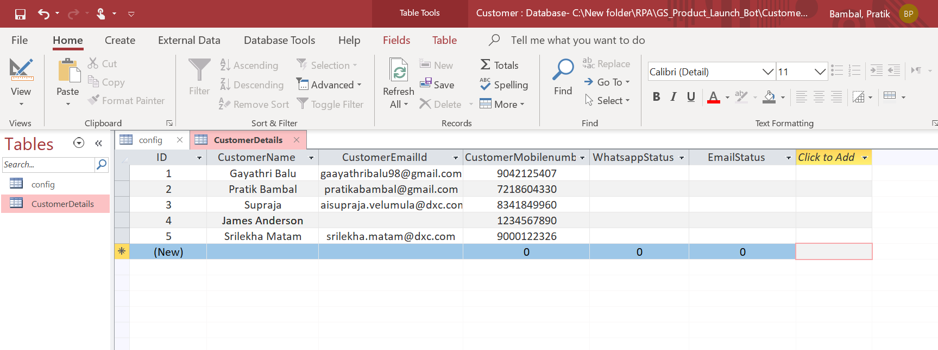
Database Design
In MSACCESS we take customer details and config file

Slide 8
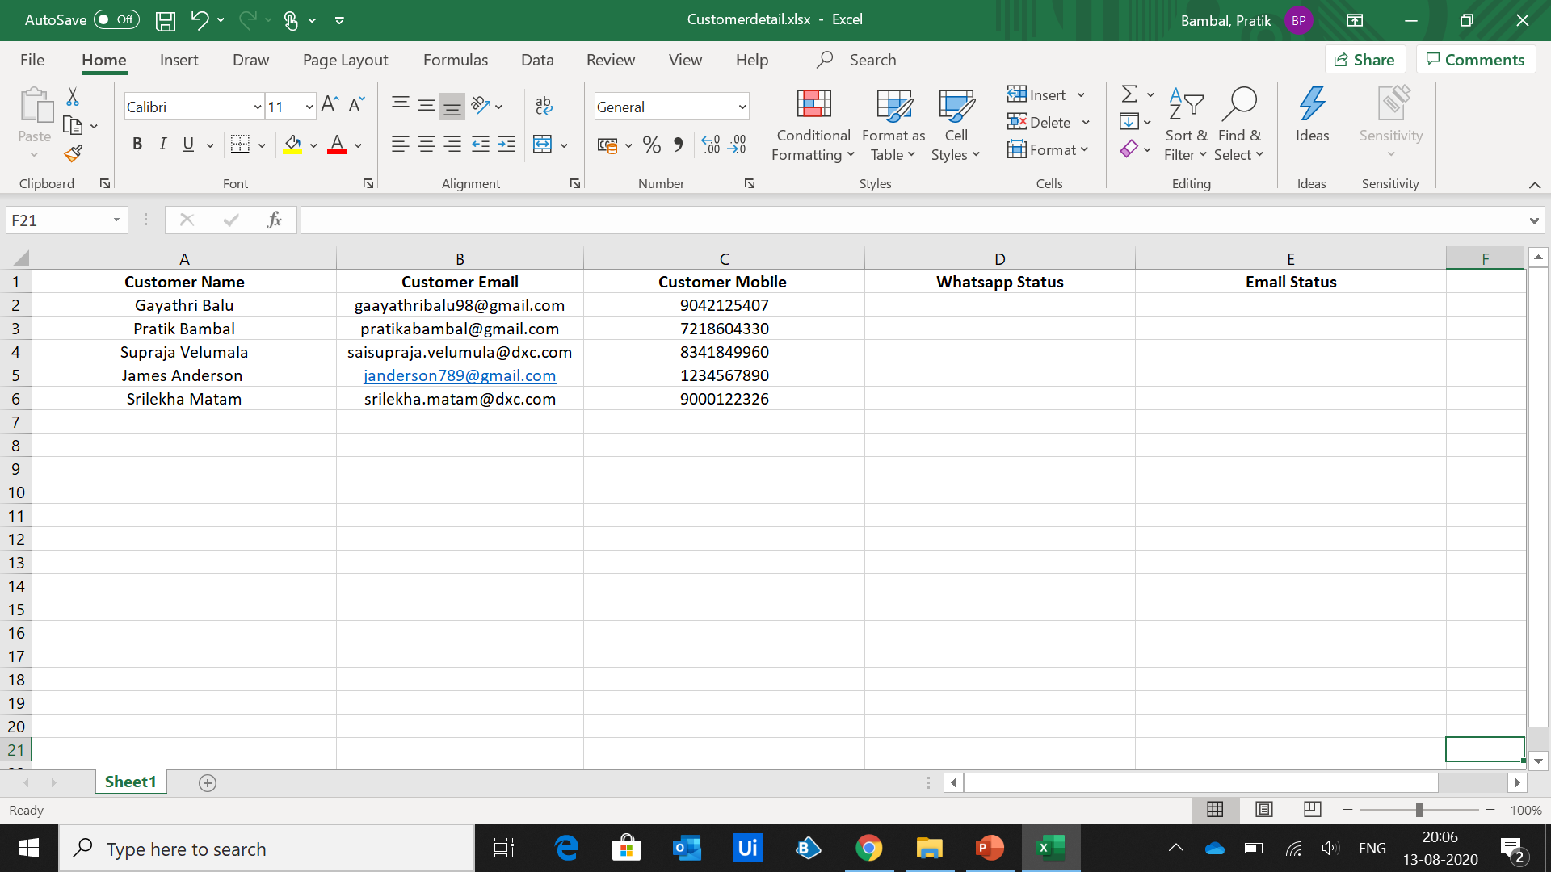
Excel Extraction
From MSACCESS the Customer details are being extracted to Excel File.

Slide 9
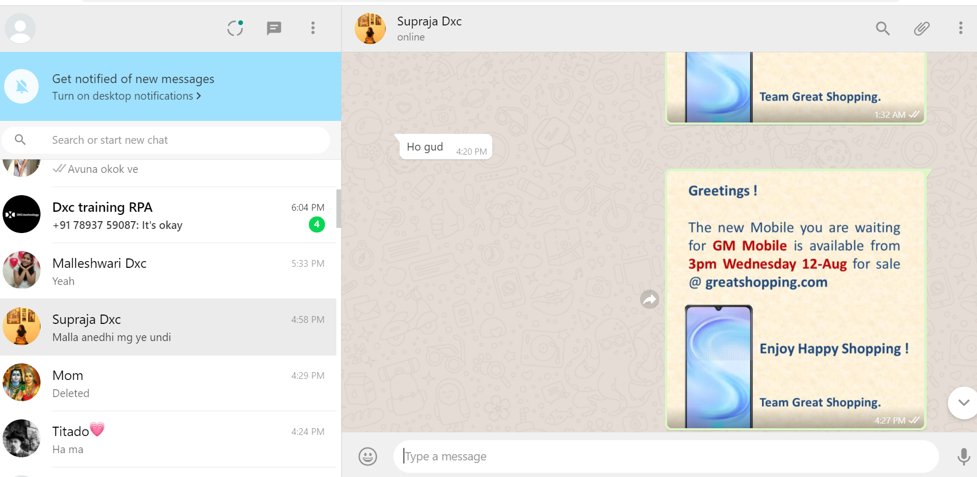
WhatsApp Message after Execution of Bot
From the Customer details excel file Customer Mobile number is taken for sending the whatsapp message.

Slide 10
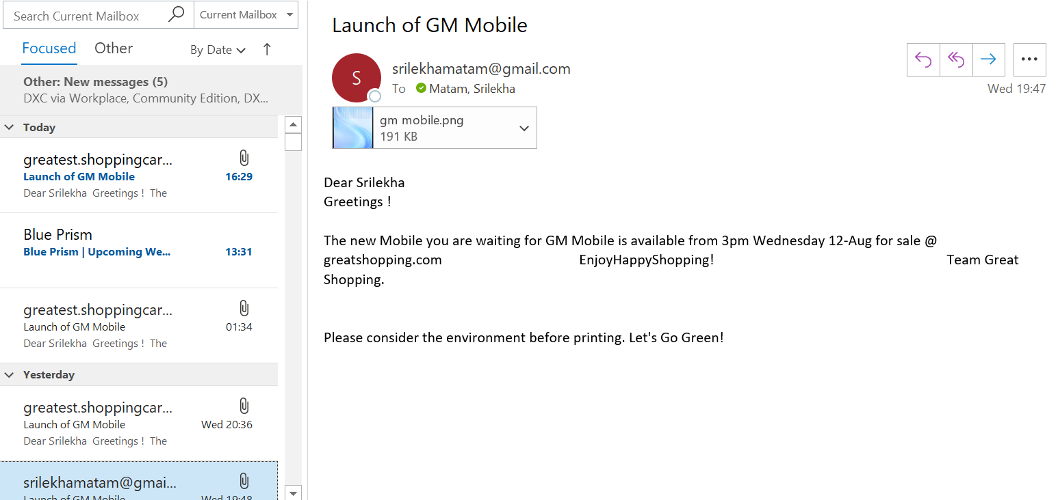
Email Message after Execution of Bot
From customer details excel sheet the customer mail id will be read and the email will be sent.
The email will be able to sent to both g-mail and outlook as well.

Slide 11
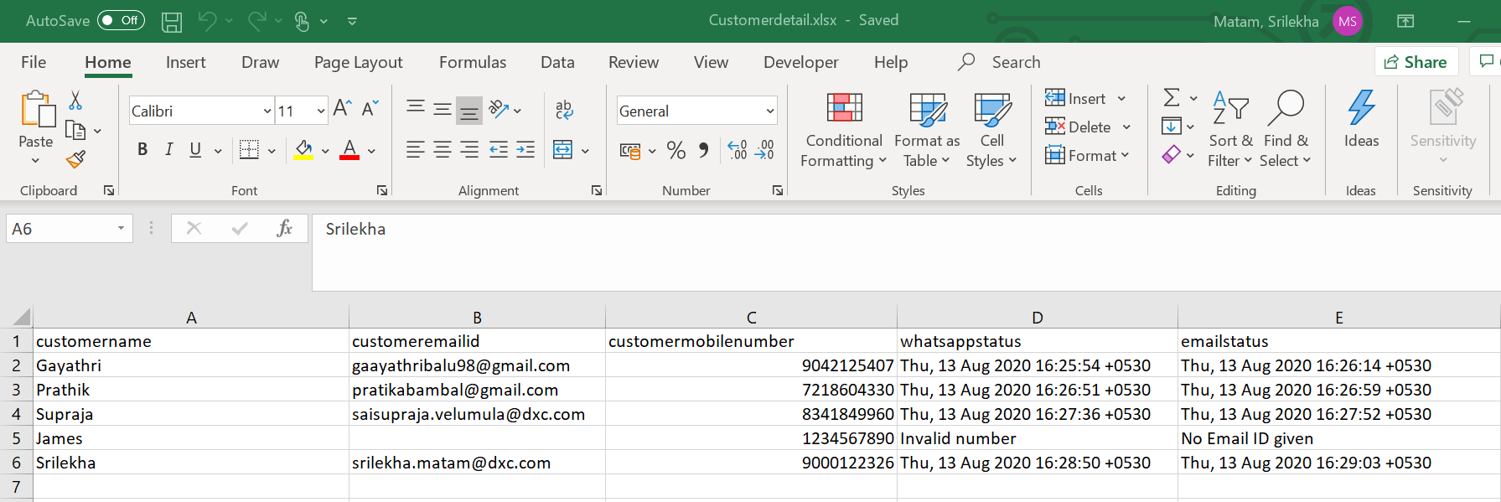
Excel Sheet after Bot Execution
After the entire process execution is completed the bot will update the status of whatsapp email status in the excel sheet.

Slide 12
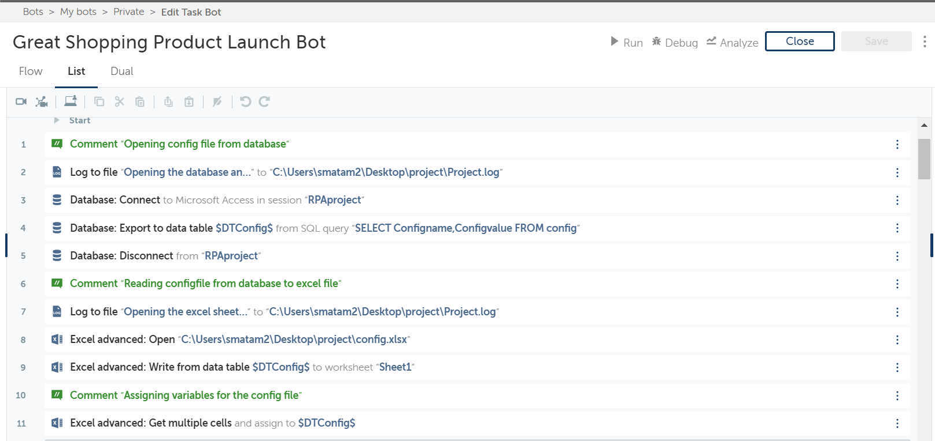
Bot Actions

Slide 13
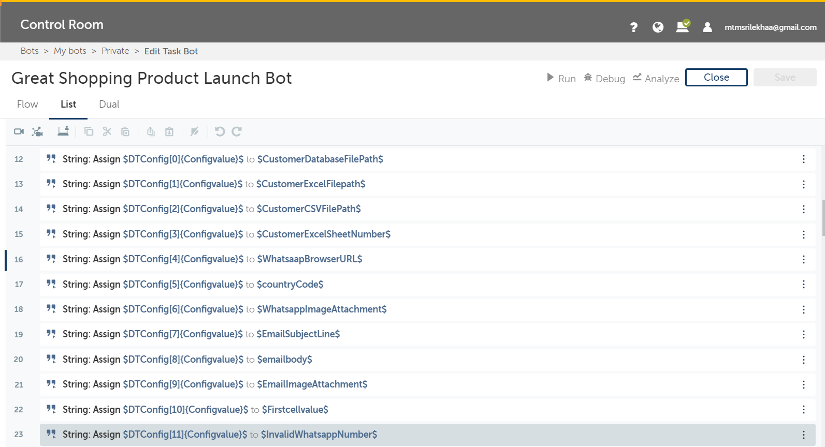
Bot Actions

Slide 14
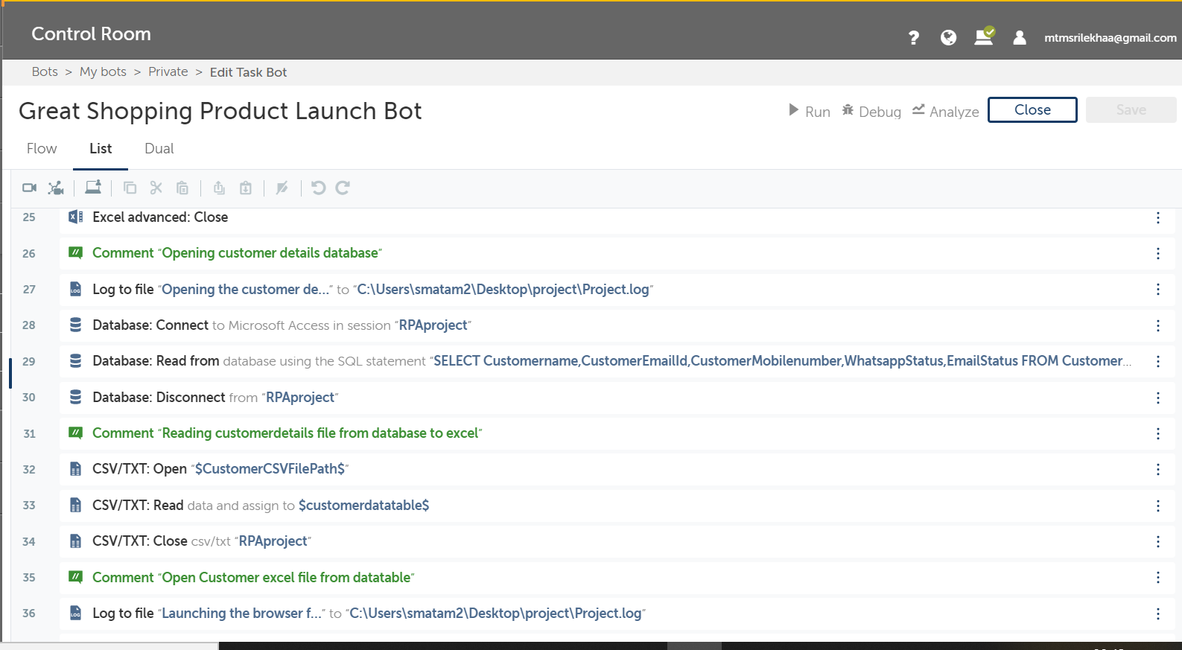
Bot Actions

Slide 15
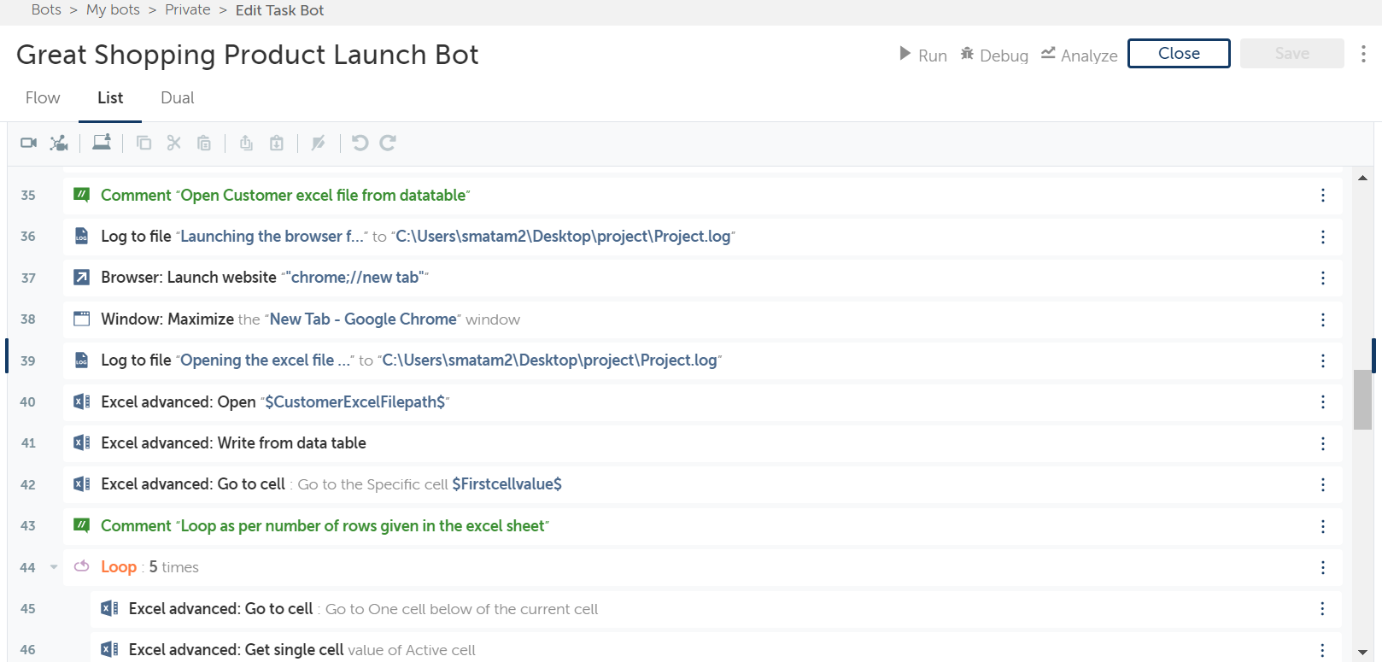
Bot Actions

Slide 16
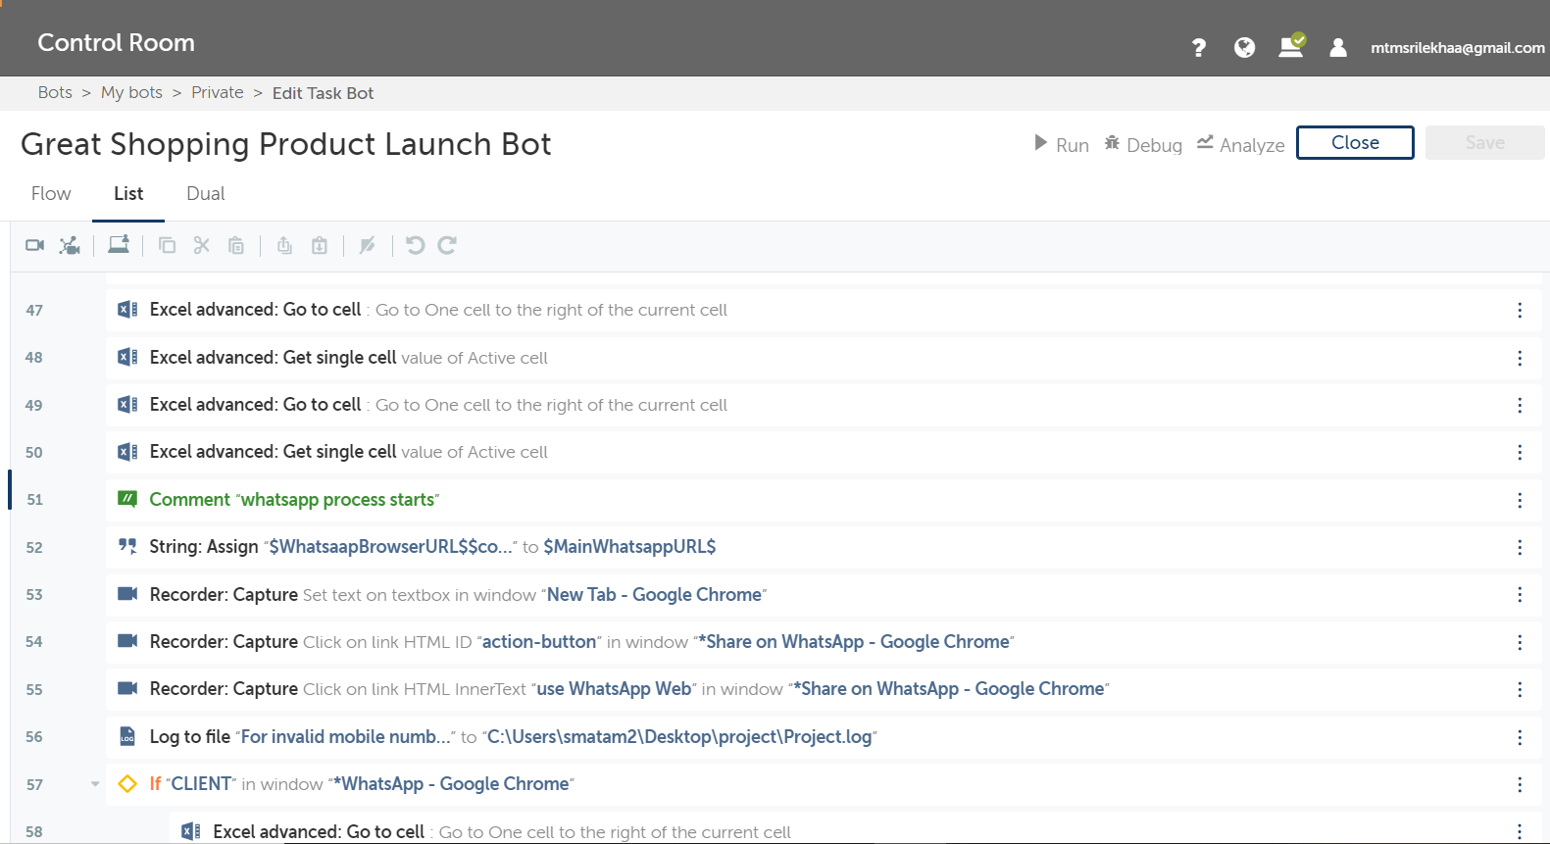
Bot Actions

Slide 17
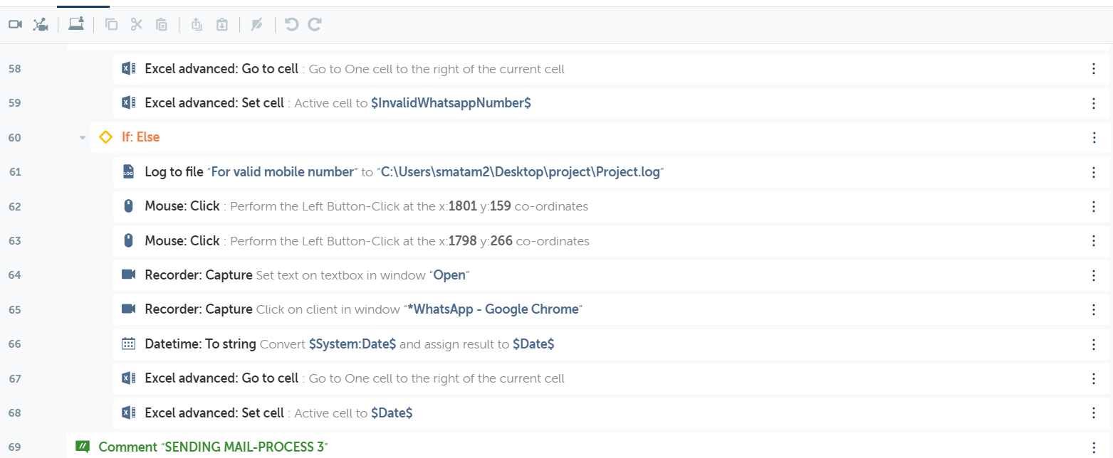
Bot Actions

Slide 18
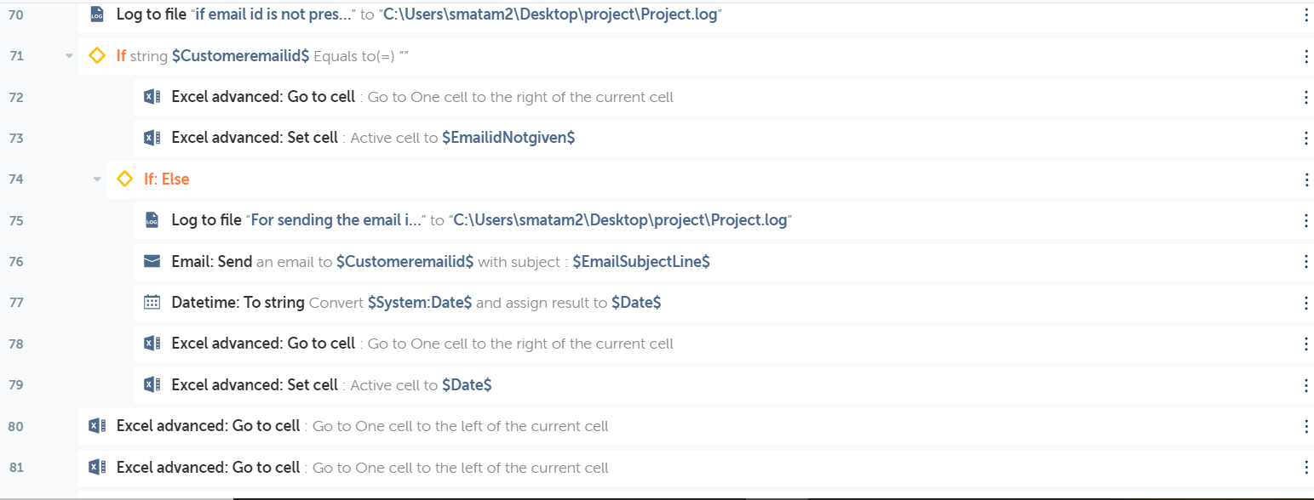
Bot Actions

Slide 19
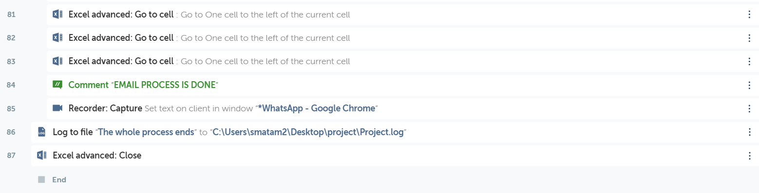
Bot Actions

Slide 20
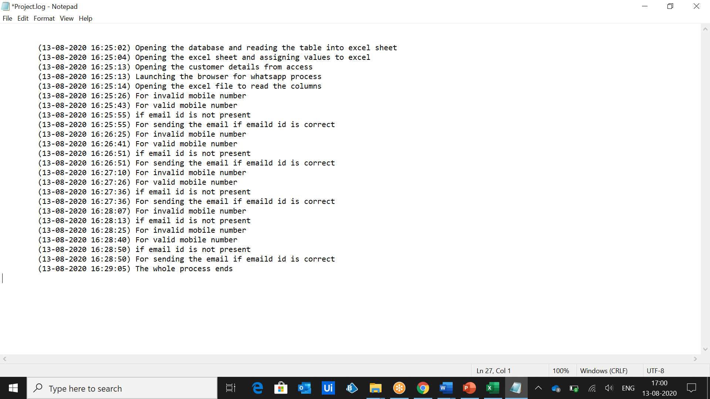
Log File
Status of each process will be updated in the log file.

Slide 21
Thank You

